Slide 1


Pay differences in
in relation to gamedev

Slide 2
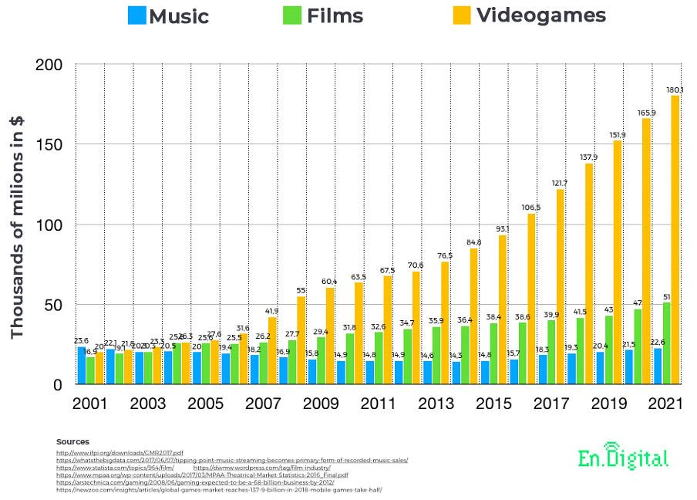

Slide 3
Gender wage gap?
No

Slide 4
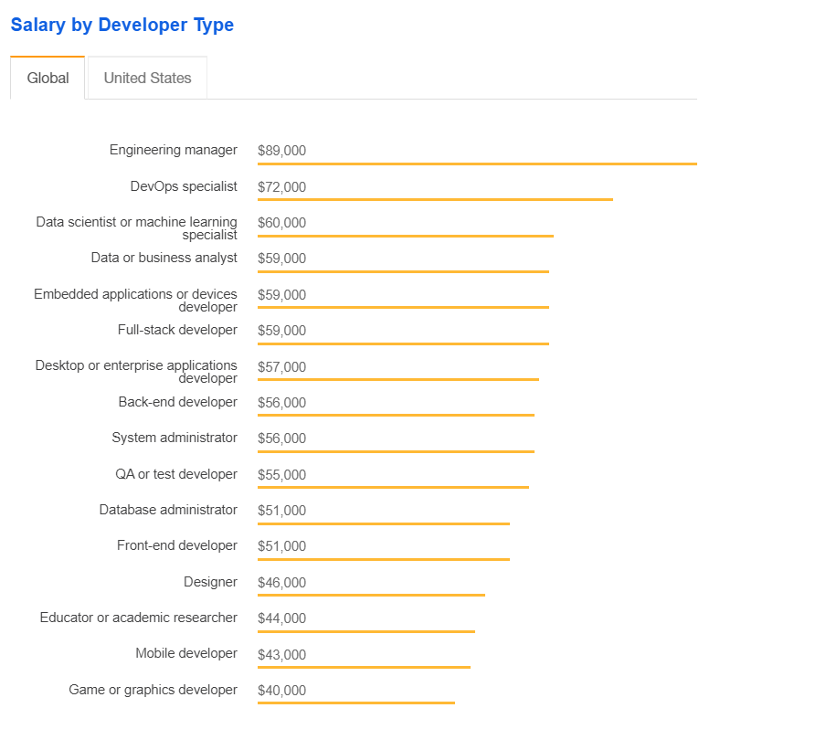

Slide 5
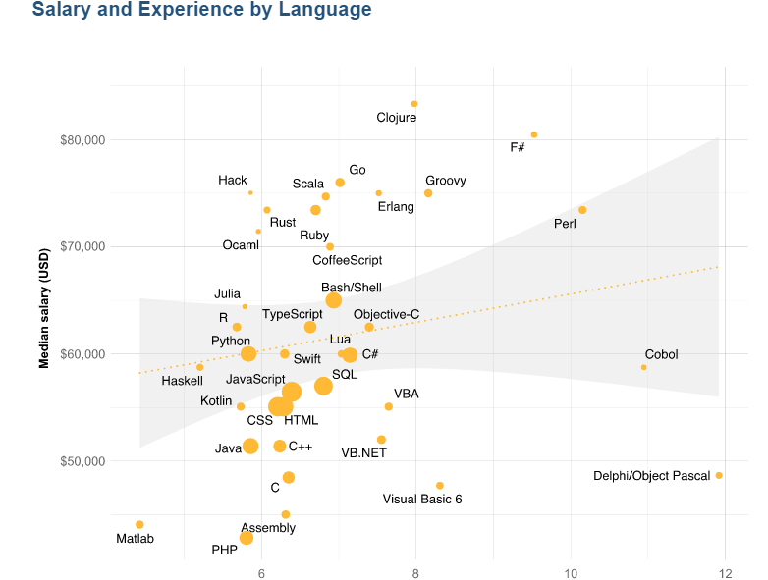

Slide 6
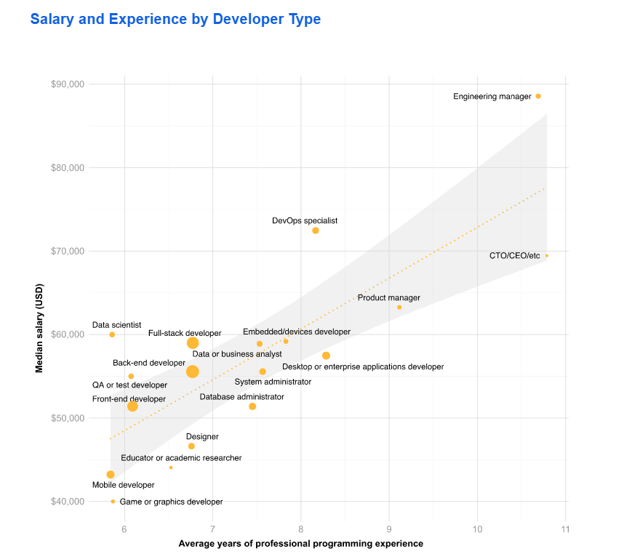

Slide 7
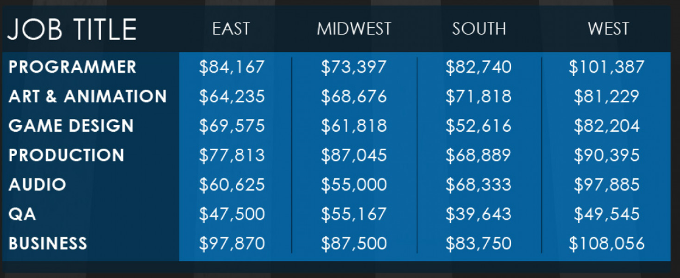
Difference by career within gamedev

Slide 8
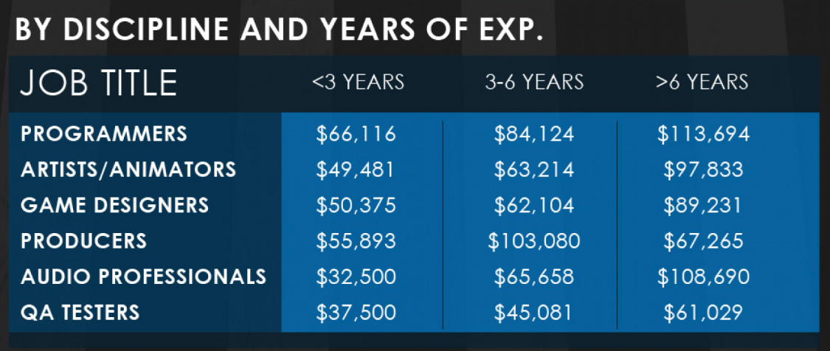
Difference by experience within gamedev

Slide 9

Agreeable or disagreeable

Slide 10

Bonus on pay

Slide 11

Sussudio

